Slide 1

The Adventures of an Author

Slide 2


The Start of My Writing Career

Slide 3


2019… Oh 2019
August 12th, 2019

Slide 4
Mental Health Issues
Seasonal Affective Disorder
Depression
Anxiety
PTSD
Insomnia

Slide 5
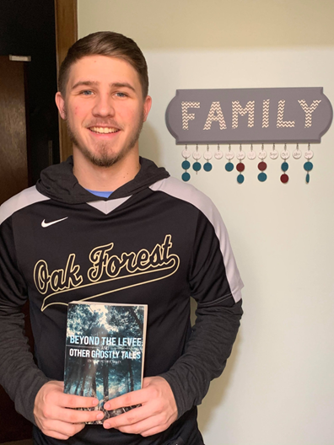
2020 - First Time Published Professionally

Slide 6
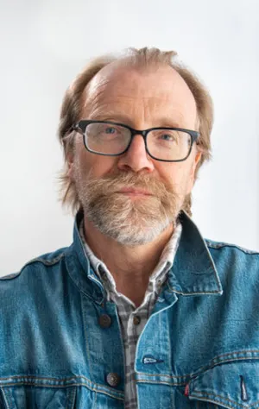
Trusting the Process
Write, Write, Write
Edit, Edit, Edit
REPEAT!
REPEAT AGAIN!
AGAIN!
Submit
Wait… sometimes forever

Slide 7



My Process – Self Publishing

Slide 8






My Process - Submitting

Slide 9



The Future

Slide 10
Thank You!

